Slide 1

Algorithms & Data Structures
Week 2
Linked lists & Queues

Slide 2
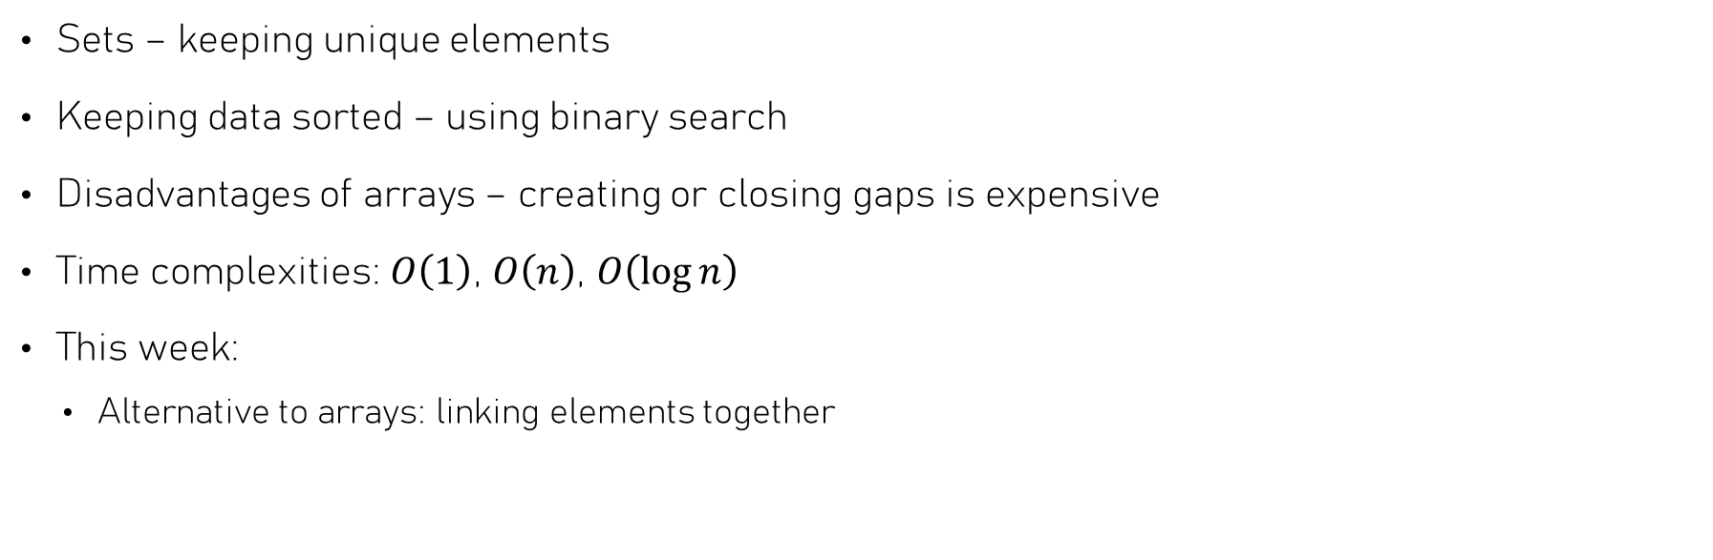
Last week we discussed…
Sets – keeping unique elements
Keeping data sorted – using binary search
Disadvantages of arrays – creating or closing gaps is expensive
Time complexities: $O\left(1\right)$, $O\left(n\right)$, $O\left(\log{n}\right)$
This week:
  Alternative to arrays: linking elements together

Slide 3

Chaining data together
Using linked lists

Slide 4

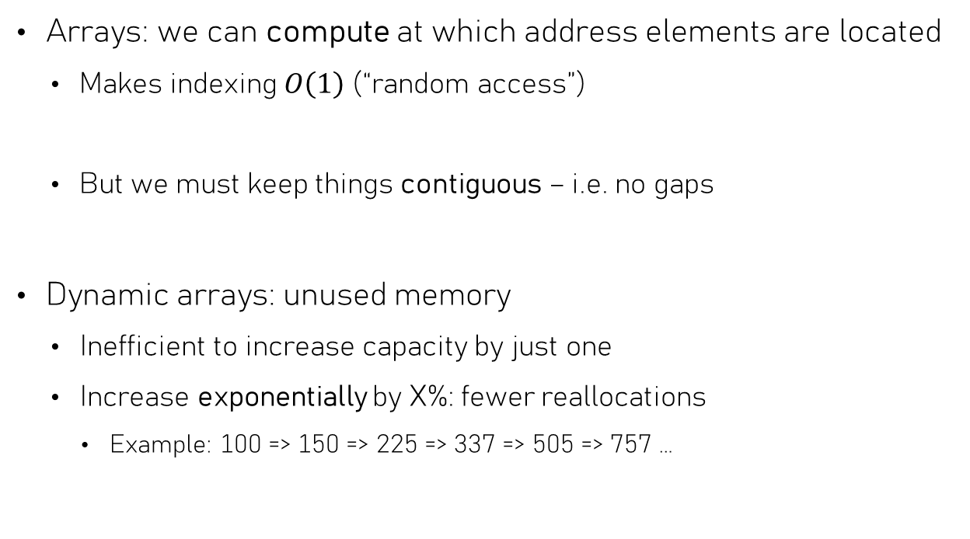
(Dis)advantages of arrays
Memory address
Arrays: we can compute at which address elements are located
  Makes indexing $O\left(1\right)$ (“random access”)
  But we must keep things contiguous – i.e. no gaps
Dynamic arrays: unused memory
  Inefficient to increase capacity by just one
  Increase exponentially by X%: fewer reallocations
    Example: 100 => 150 => 225 => 337 => 505 => 757 …
0x00
0x04
0x08
0x0C
0x10
0x14
0x18
42
17
2
67
8
1
5
42
17
2
67
1
5
42
17
2
67
8
1
5
unused

Slide 5
An alternative using pointers
Memory
This data structure is called a Linked list
  Use only the memory we need, no reallocation needed
  No need to prevent “gaps”!
  Difficult to “index” to get a certain value
NULL
10
30
40
20
25
typedef struct Node {
int data;
struct Node* next;
} Node;
A Linked list node in C

Slide 6
Singly linked lists
10
next
20
next
30
next
40
next
NULL
Singly linked list: each node “points” to next node
Easy to:
  Prepend (and possibly, append) a node
  Insert a new node after a given node
  Remove the first node
List
NOTE: Nodes may be
anywhere in memory!
first
last
typedef struct Node {
int data;
struct Node* next;
} Node;
typedef struct List {
Node* first;
Node* last;
} List;
A singly linked list in C

Slide 7

Singly linked lists
int get(const List *list, size_t index) {
const Node* ptr = list->first;
while (ptr != nullptr && index > 0) {
ptr = ptr->next;
index--;
}
return ptr->value; // might crash!
}
“Indexing” is more challenging than for arrays
  Can’t compute memory address of element at index idx
  Instead, need loop – time complexity: $O\left(n\right)$! (sequential access)
ptr
2
next
5
next
10
next
20
next
30
next
40
next
NULL
index = 4
index = 3
index = 2
index = 1
index = 0
List
first
last

Slide 8

Singly linked lists
How about
appending a node?
Prepend a node - makes a new node the first node
  Requires updating the first pointer
  Independent of length of list, so $O\left(1\right)$!
5
next
10
next
20
next
30
next
40
next
NULL
void prepend(
List *list,
Node *new_node);
List
first
last

Slide 9

Singly linked lists
Insert a new node after a given node
  Requires updating the given node’s next pointer
  Effort independent of length of list, so $O\left(1\right)$!
void insert_after(
Node *given,
Node *new_node);
35
How about inserting before a node?
next
next
10
next
20
next
30
next
40
next
NULL
List
given
first
last

Slide 10

Singly linked lists
Remove the first node
  Requires updating the first pointer
  Independent of length of list, so $O\left(1\right)$!
void remove_first(List *list);
10
next
20
next
30
next
40
next
NULL
How about removing the last node?
first
List
first
last

Slide 11
Doubly linked list
NULL
prev
next
next
next
next
10
20
30
40
prev
prev
prev
Each node points to next and previous node
Easier to:
  Insert a new node before any given node
  Remove any given node
List
NOTE: Nodes may be
anywhere in memory!
first
last
typedef struct Node {
int data;
struct Node* next;
struct Node* prev;
} Node;
typedef struct List {
Node* first;
Node* last;
}

Slide 12
Doubly linked list
Beware of the pointer modifications
  Order is important!
Remove (unlink) node:
node->prev->next = node->next;
node->next->prev = node->prev;
Doesn’t work for first / last
  It’s complicated…
NULL
prev
next
next
next
next
10
20
30
40
NULL
prev
prev
prev
List
first
last

Slide 13
Lists versus Arrays
Dynamic array
Possible inefficient use of memory
No gaps allowed, slow shifting – $O\left(n\right)$
No gaps allowed, slow shifting – 𝑂(𝑛)
Fast indexing – $O\left(1\right)$
Fast indexing – 𝑂(1)
Linked List
Efficient use of memory
Slow indexing – $O\left(n\right)$
Slow indexing – 𝑂(𝑛)
Need to store pointer(s) for each element
Memory allocation may be slow (but $O\left(1\right)$)
Memory allocation may be slow (but 𝑂(1))

Slide 14
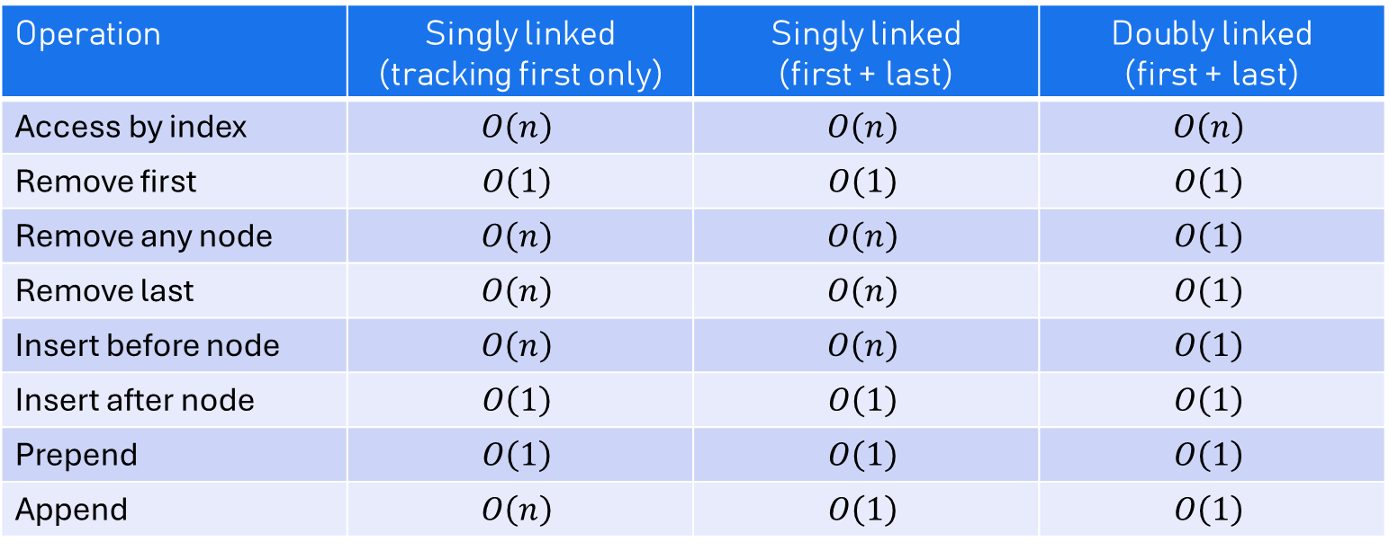
Linked lists – time complexities
Operation | Singly linked (tracking first only) | Singly linked (first + last) | Doubly linked (first + last)
Access by index | $$O\left(n\right)$$ | $$O\left(n\right)$$ | $$O\left(n\right)$$
Remove first | $$O\left(1\right)$$ | $$O\left(1\right)$$ | $$O\left(1\right)$$
Remove any node | $$O\left(n\right)$$ | $$O\left(n\right)$$ | $$O\left(1\right)$$
Remove last | $$O\left(n\right)$$ | $$O\left(n\right)$$ | $$O\left(1\right)$$
Insert before node | $$O\left(n\right)$$ | $$O\left(n\right)$$ | $$O\left(1\right)$$
Insert after node | $$O\left(1\right)$$ | $$O\left(1\right)$$ | $$O\left(1\right)$$
Prepend | $$O\left(1\right)$$ | $$O\left(1\right)$$ | $$O\left(1\right)$$
Append | $$O\left(n\right)$$ | $$O\left(1\right)$$ | $$O\left(1\right)$$
Choice of array vs singly linked list vs doubly linked list: depends on required operations!

Slide 15

Queues
First in, first out

Slide 16
Queues
Queue: First one to enter = First one to be served
Abstract data structure that ensures reads & writes occur in FIFO order
Only two operations:
  Enqueue
  Dequeue
First In, First Out (FIFO)

Slide 17
Queues – FIFO order
Enqueue Alice
Enqueue Bob
Enqueue Charlie
Dequeue
Alice
First In, First Out
Doesn’t matter at what time you entered the queue!
Great for communication
  Example: Sending packets over network
Enqueue Frank
Dequeue
Bob
Enqueue Dave
Enqueue Eve
Dequeue
Charlie
Dequeue
Frank
Dequeue
Dave
Dequeue
Eve

Slide 18
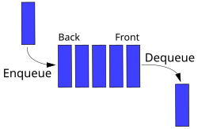
Queues
Queues are abstract data structures (like Sets)
  We’re free to implement it in some (hopefully efficient) way
If you had to choose between arrays and linked lists, which would you choose and why?

Slide 19




(Singly) linked lists as queues
Where to enqueue (insert), where to dequeue (remove)?
$$O\left(1\right)$$
$$O\left(n\right)$$
!
next
o
next
l
next
l
next
e
next
H
next
EnQ: Prepend
DeQ: Remove last
Option 1
NULL
first
last
$$O\left(1\right)$$
$$O\left(1\right)$$
H
next
e
next
l
next
l
next
o
next
!
EnQ: Append
DeQ: Remove first
Option 2
NULL
first
last

Slide 20
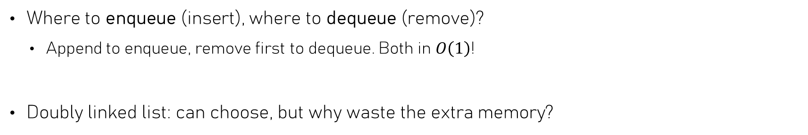
(Singly) linked lists as queues
Where to enqueue (insert), where to dequeue (remove)?
  Append to enqueue, remove first to dequeue. Both in $O\left(1\right)$!
Doubly linked list: can choose, but why waste the extra memory?
$$O\left(1\right)$$
$$O\left(1\right)$$
H
next
e
next
l
next
l
next
o
next
!
EnQ: Append
DeQ: Remove first
Option 2
NULL
first
last

Slide 21



Arrays as queues
We can do better than that!
Where to enqueue (insert), where to dequeue (remove)?
  Let’s try: append to enqueue, remove first to dequeue.
  Alternative: prepend to enqueue, remove last to dequeue
  No help, one of the two will always be $O\left(n\right)$
$$O\left(1\right)$$
(Average case)
H
e
l
l
o
,
w
o
r
l
d
!
$$O\left(n\right)$$

Slide 22
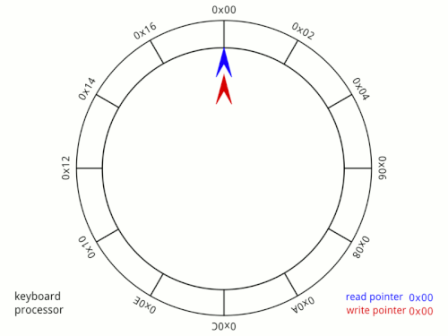
Circular buffers
Using arrays as queues, properly
Image source: Wikipedia

Slide 23
Circular buffers
Why should we store the first element at index 0?
  Instead, maintain two pointers: readptr & writeptr
  Dequeue: retrieve value from readptr location, then increase readptr
  Enqueue: store value at location pointed to by writeptr, then increase writeptr
0
1
2
3
4
5
6
7
8
9
R
L
D
H
H
E
L
L
O
W
O
writeptr
Location to store
next enqueued value
readptr
Value that is next
to be dequeued

Slide 24
Circular buffers – wrapping around the end
When increasing a pointer beyond the end of the array, reset back to 0.
  Can be done using the modulo operator: %
void buffer::write(char c) {
array[writeptr_] = c;
writeptr_ = (writeptr_ + 1) % size_;
}
“Old” data is there until overwritten
0
1
2
3
4
5
6
7
8
9
#
:
\n
H
E
L
L
O
W
3
O
readptr
Value that is next
to be dequeued
writeptr
Location to store
next enqueued value

Slide 25
Circular buffers – empty / full?
When readptr = writeptr, this can mean two things: buffer is empty or full
  To distinguish, we need to track the number of elements stored
  If buffer is full, can ‘t enqueue until a dequeue is done first
0
1
2
3
4
5
6
7
8
9
R
L
D
H
E
L
L
O
W
3
count = 10
O
Buffer is full
readptr
writeptr
0
1
2
3
4
5
6
7
8
9
R
L
D
H
E
L
L
O
W
3
count = 0
O
Buffer is empty
readptr
writeptr

Slide 26
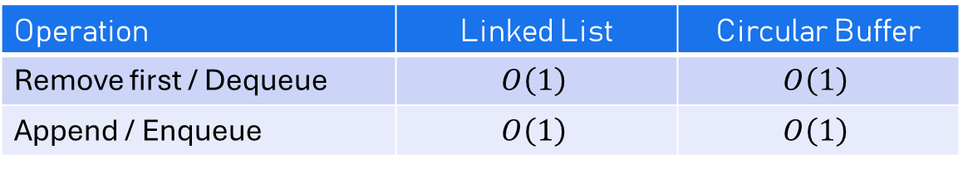
Circular buffers vs linked lists: comparison
This doesn’t mean they’re equally fast!
Operation | Linked List | Circular Buffer
Remove first / Dequeue | $$O\left(1\right)$$ | $$O\left(1\right)$$
Append / Enqueue | $$O\left(1\right)$$ | $$O\left(1\right)$$
Other factors:
Circular buffer typically has fixed size (but can be avoided)
Arrays are faster because their contents are typically cached
Linked list node allocation can be optimized through clever allocation
…

Slide 27
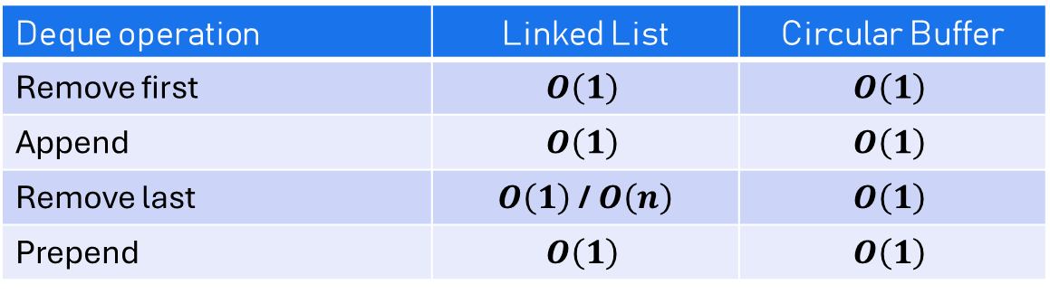
From Queue to Deque
A queue provides access to its two ends:
  “read” access to one end, “write” access to the other end
A double-ended queue or deque provides read & write access to both of its ends
Deque operation | Linked List | Circular Buffer
Remove first | $$O\left(1\right)$$ | $$O\left(1\right)$$
Append | $$O\left(1\right)$$ | $$O\left(1\right)$$
Remove last | $O\left(1\right)$ / $O\left(n\right)$ | $$O\left(1\right)$$
Prepend | $$O\left(1\right)$$ | $$O\left(1\right)$$

Slide 28
Sliding windows
H
E
L
L
O
W
O
R
L
3
D
The sliding window programming technique

Slide 29
A Sliding window problem
Signing off
(t = 232)
😴😴😴😴
(t = 230)
1 + 1 = 10
(t = 217)
smh fr
(t = 203)
YAAAWN 🥱🥱
(t = 191)
Roger!
(t = 182)
LOL no way!
(t = 163)
Linked array?
(t = 146)
What if...
(t = 125)
big O what?
(t = 118)
Sliding, eh?
(t = 105)
omw 🚗💨
(t = 75)
brb, coffee☕
(t = 70)
afk?
(t = 45)
wyd rn?
(t = 35)
Hello, world!
(t = 5)
Messages come in, timestamped (in seconds)
What is the highest nr. of messages received within one minute?
Solve using a Queue!
  On enqueue: dequeue elements 60 or more seconds older than newest
Queue(3): 35 seconds
Queue(4): 40 seconds
Queue(5): 70 seconds
Queue(4): 65 seconds
Queue(4): 60 seconds
Q(3): 40 seconds
5s
35s
45s
70s
75s
105s
etc, etc, …

Slide 30
Sliding windows using two pointers
Instead of using a queue, we can “slide” a “window“ over an array (or linked list)
Example: find longest sequence of non-repeating characters in an array
solution
A
B
A
B
C
B
D
A
A
3
B
last
next

Slide 31
Example sliding window problems
Find longest substring without repeating characters
Find all indices in some text at which an anagram of some string occurs (assignment)
Filtering: median filter (e.g. of width 5) to remove noise
LeetCode 933 – Number of Recent Calls
A
B
A
B
C
B
D
A
A
3
B
"parliament" in "the debate was led by partial men"
1
-1
2
5
0
9
6
7
6
3
5
1
1.5
1
2
5
6
6
6
6
3
6

Slide 32
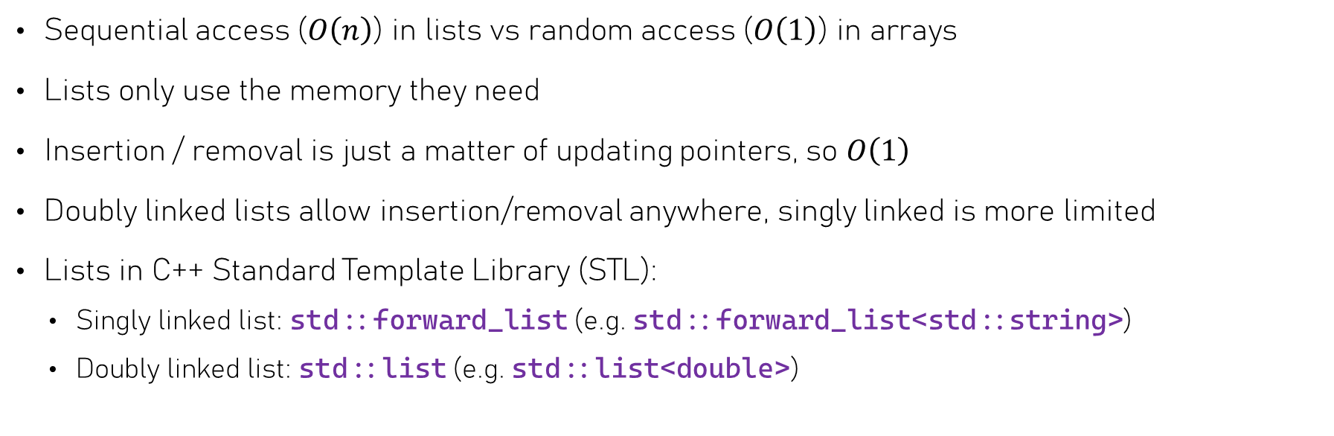
Summary – Linked lists
Would you use a linked list to implement a set?
Sequential access ($O\left(n\right)$) in lists vs random access ($O\left(1\right)$) in arrays
Lists only use the memory they need
Insertion / removal is just a matter of updating pointers, so $O\left(1\right)$
Doubly linked lists allow insertion/removal anywhere, singly linked is more limited
Lists in C++ Standard Template Library (STL):
  Singly linked list: std::forward_list (e.g. std::forward_list<std::string>)
  Doubly linked list: std::list (e.g. std::list<double>)

Slide 33
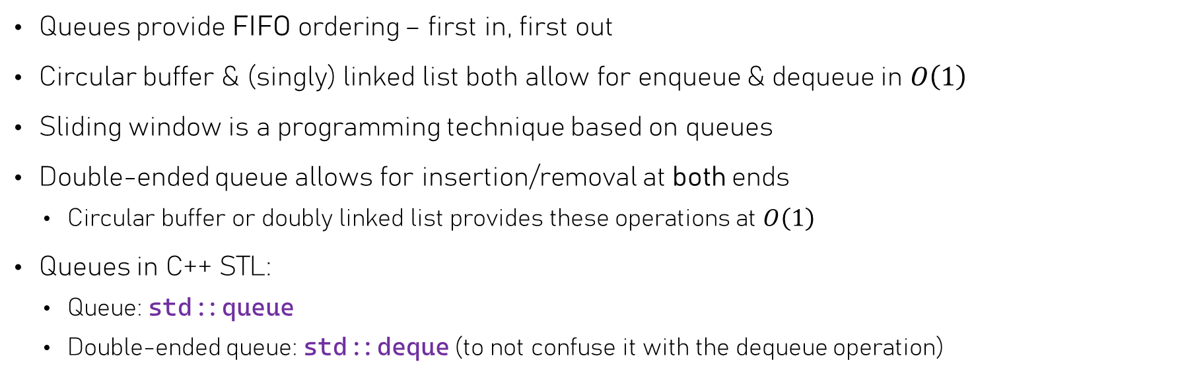
Summary – Queues
Queues provide FIFO ordering – first in, first out
Circular buffer & (singly) linked list both allow for enqueue & dequeue in $O\left(1\right)$
Sliding window is a programming technique based on queues
Double-ended queue allows for insertion/removal at both ends
  Circular buffer or doubly linked list provides these operations at $O\left(1\right)$
Queues in C++ STL:
  Queue: std::queue
  Double-ended queue: std::deque (to not confuse it with the dequeue operation)

Slide 34
Labs of this week
Note: to submit your assignments of this week, convert markdown to PDF
Why? Since we can annotate PDF files, but not HTML
Use pandoc to do the conversion (see assignment)

